Slide 1
CROP SECURITY FROM INTRUDERS
-Guide: Prof. V. V. SOVANI
-Creators: OMKAR KULKARNI
ANJALI JAGTAP
SHUBHAM SAGVEKAR

Slide 2
Problem Statement
Potent risk for farming is damage to crops by stray/ wild animals that are “INTRUDERS”.
Loss is not only Economical but also Emotional.
A System is need to be developed such that Intruders should get repelled from farm without getting harmed.
All this emphasizes importance of
“CROP SECURITY FROM INTRUDERS”

Slide 3
Present practice of crop protection
Manually guarding the fields:
Employing helpers
No guarantee of 100% protection of crops
Electric fence causes harm to intruders

Slide 4
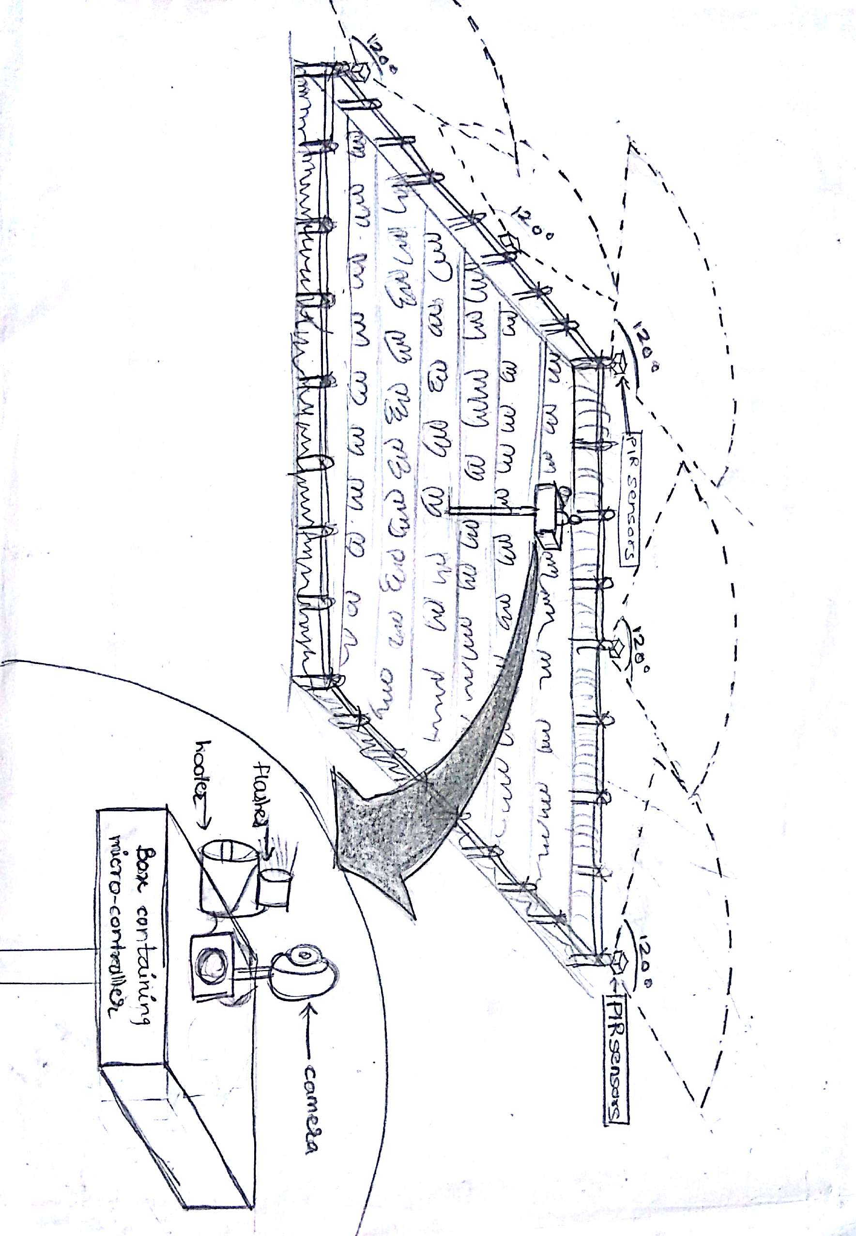
General Approach

Slide 5
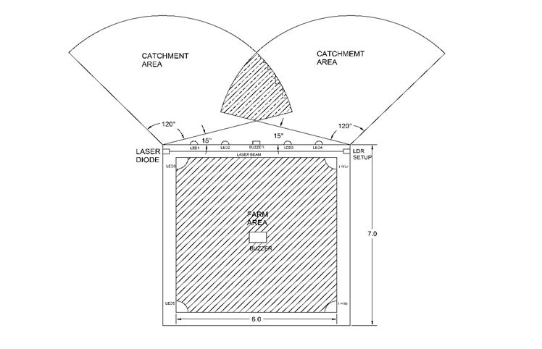
WORKING DIAGRAM

Slide 6
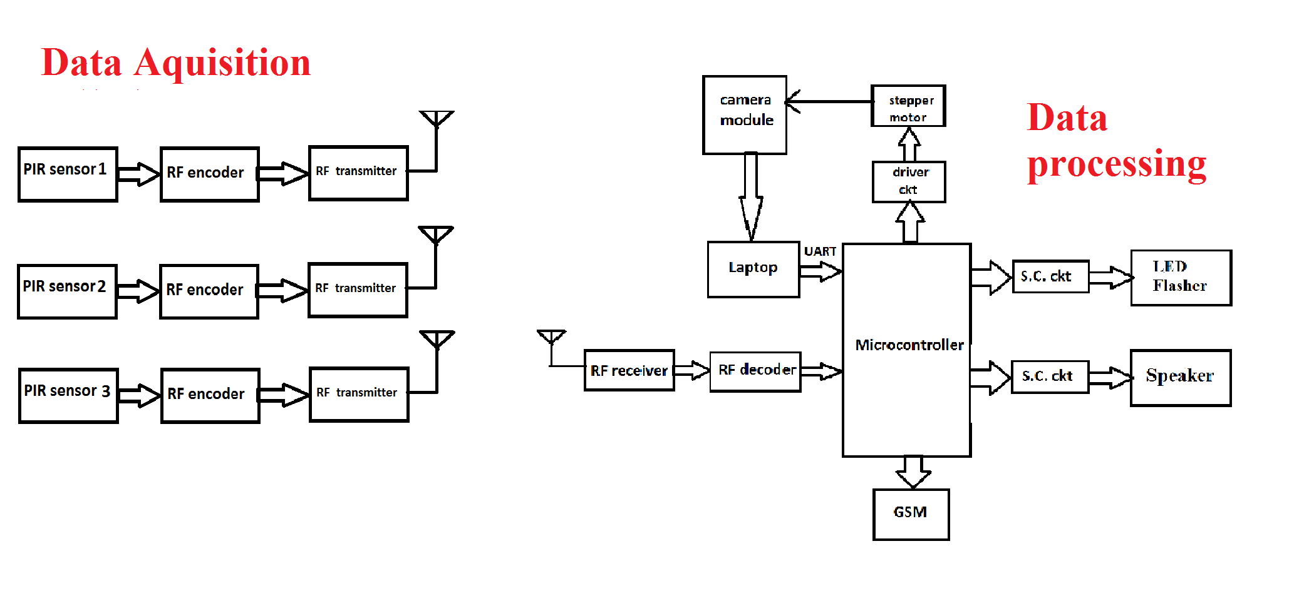
Implementation Block diagram

Slide 7
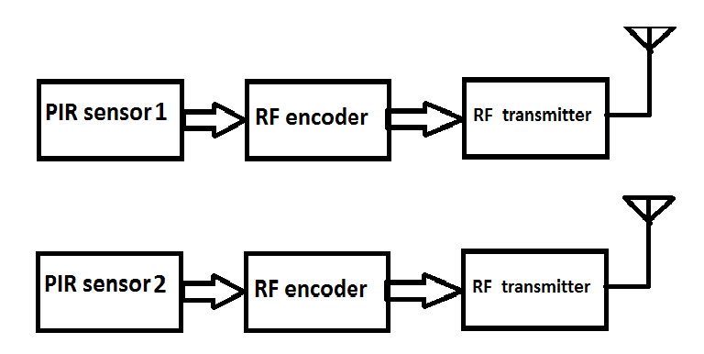
DATA ACQUISITION
Two nodes of the PIR sensor module placed at two corners of a farm boundary

Slide 8
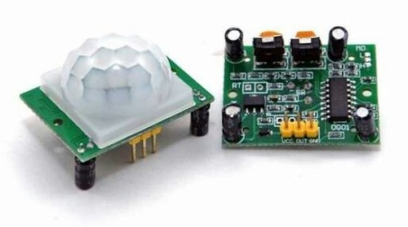
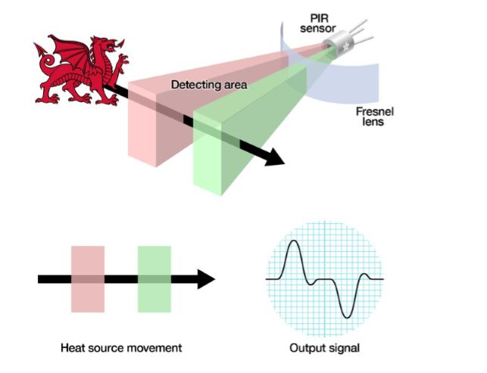
PIR Sensor

Slide 9
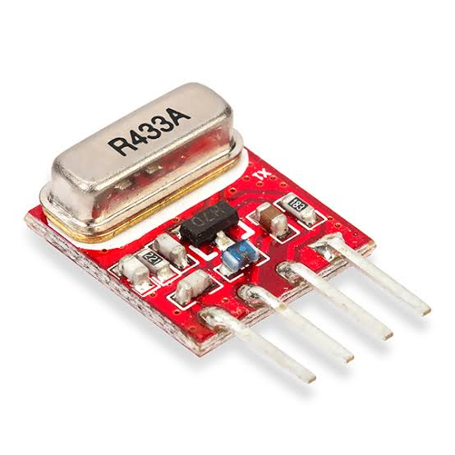
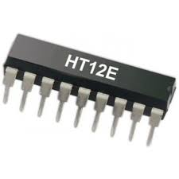
RF Encoder
RF
Transmitter
TRANSMITTER
Helps to send the acquired data to the controller

Slide 10
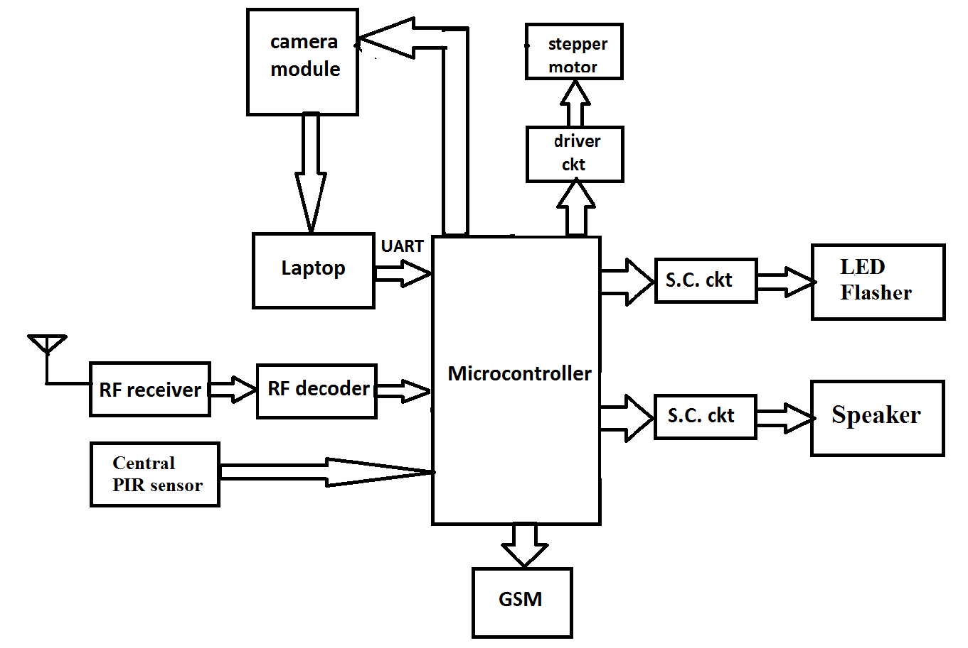
DATA PROCESSING
It situated almost at the centre of the farm to monitor intrusion inside the farm with a camera and PIR module enclosed in a box.

Slide 11
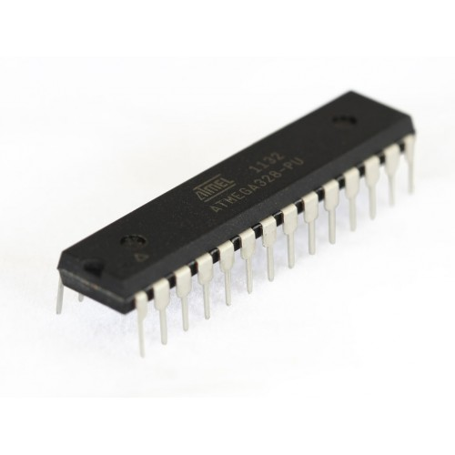
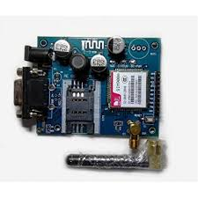
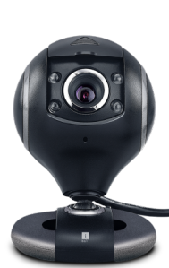
GSM
Atmega 328p
Camera
They form the core part of central unit.

Slide 12
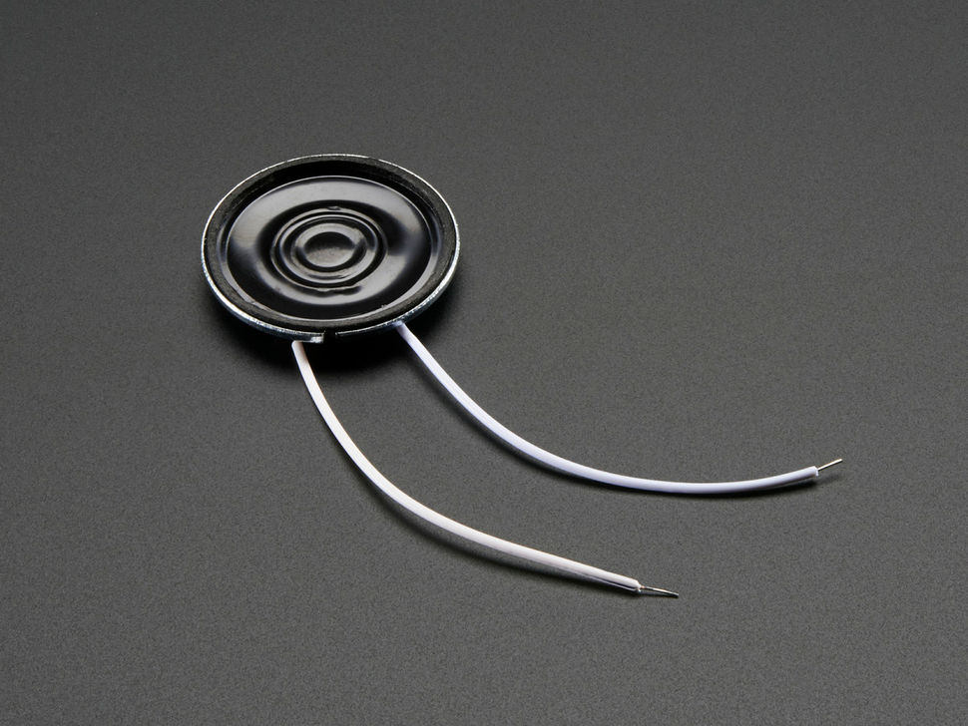
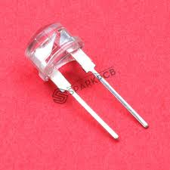
Speaker
LED
Components to repel the animals at the boundary of the farm
Driver IC

Slide 13
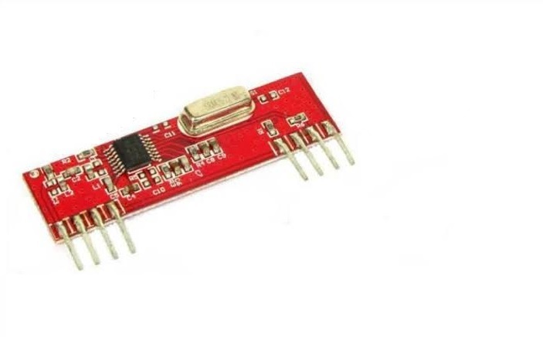
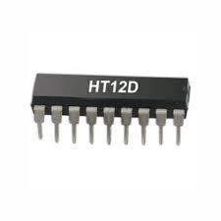
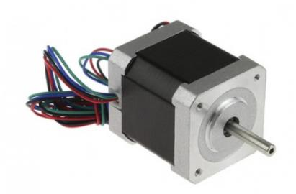
RF Decoder
RF Receiver
Stepper motor
Other components

Slide 14
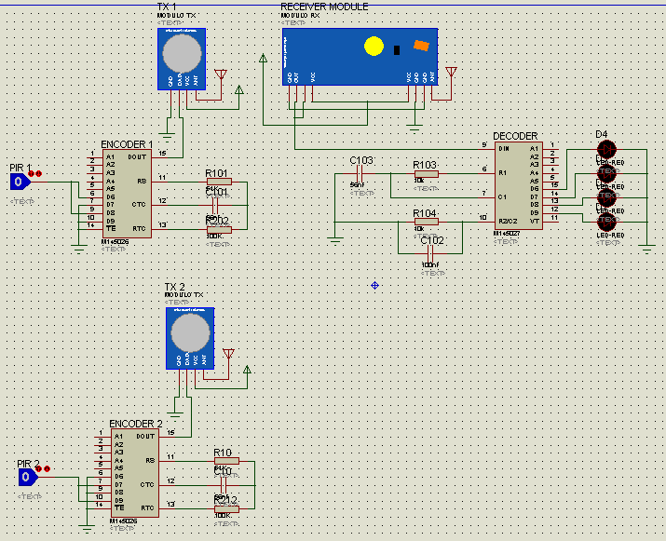
Simulation of the Hardware
PART 1

Slide 15
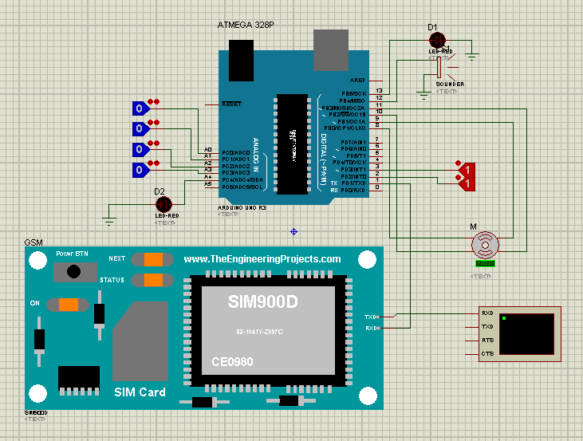
PART 2

Slide 16
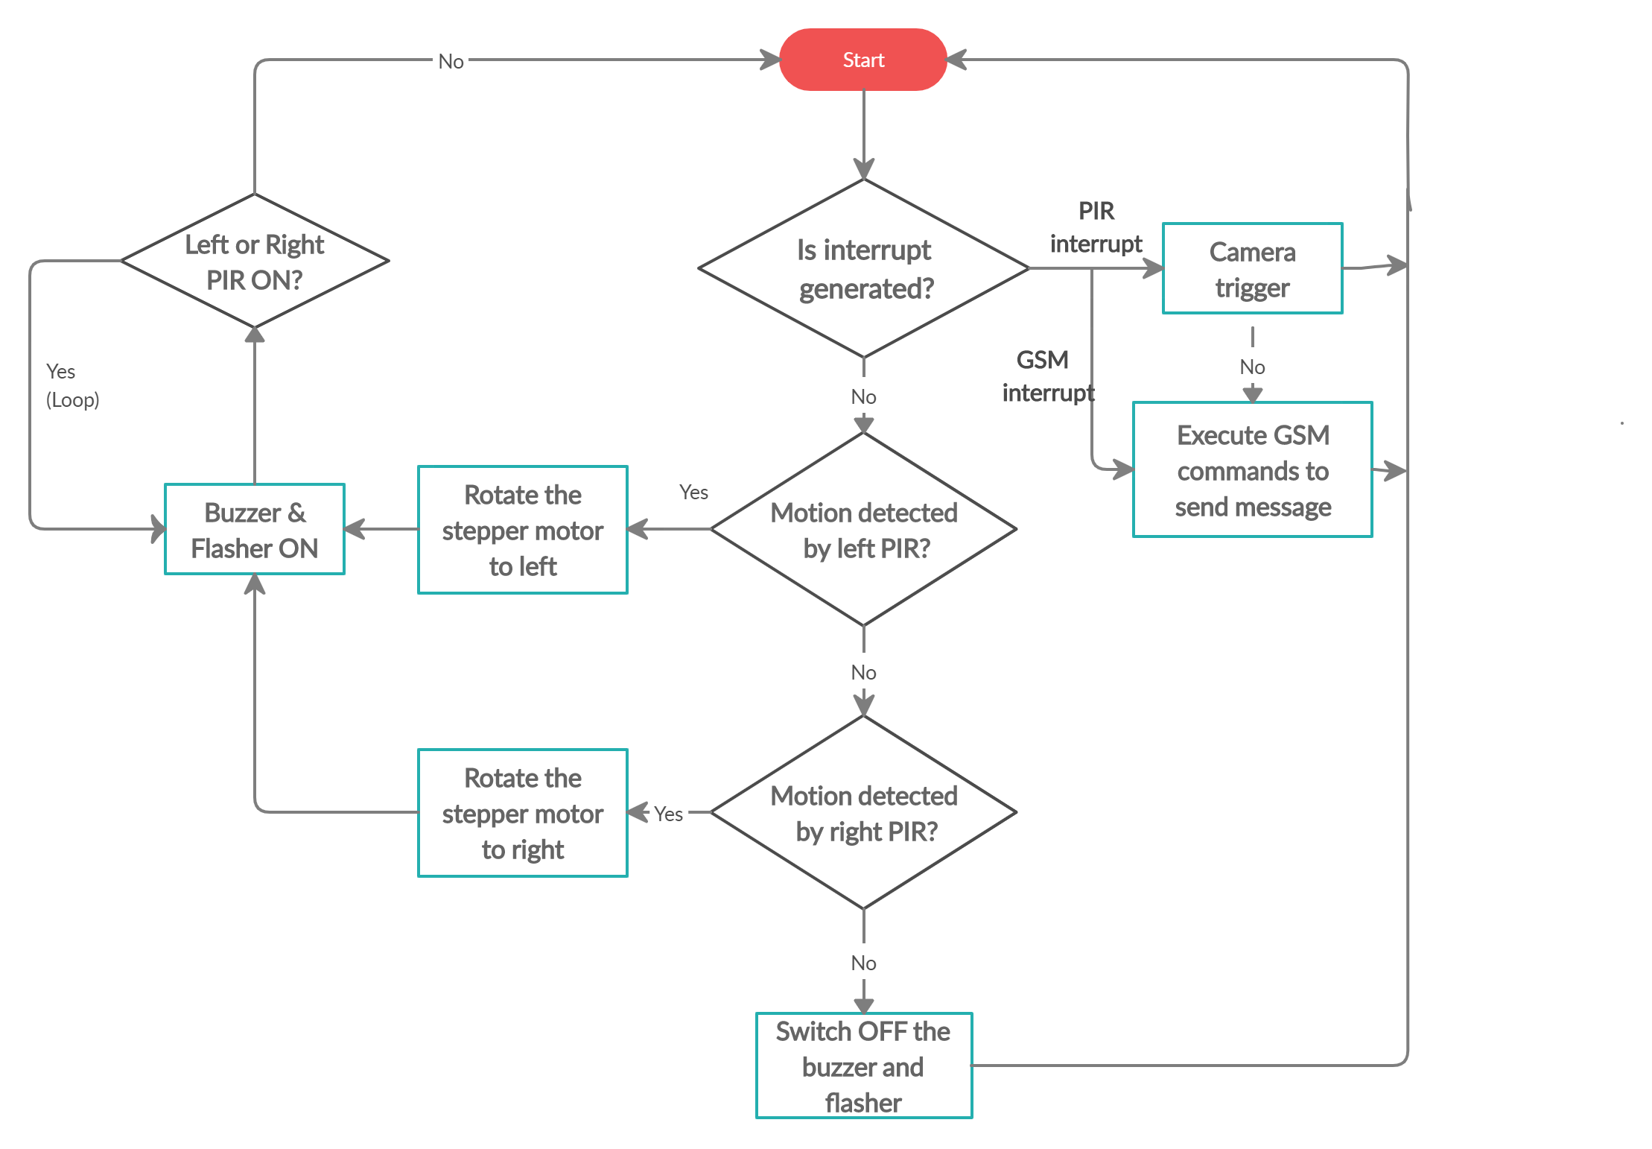
Programming the Atmega 328p

Slide 17


Slide 18
CHALLENGES IN ANIMAL DETECTION
1.Variety in animals
2.Different body postures
3.Light conditions
4.Mobility of animals
5. No. of animals(individual/heard)

Slide 19
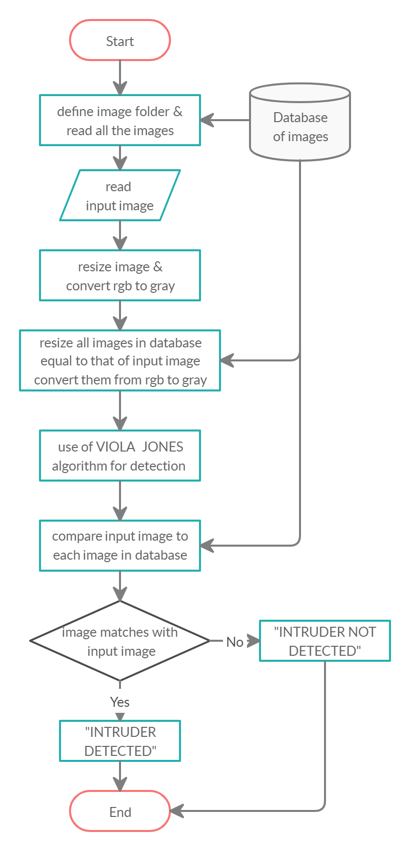
Flow of the Algorithm

Slide 20

Software used for DIP
It is easy to use.
It is quick to learn due to good documentation.
It has various toolboxes for functions.

Slide 21
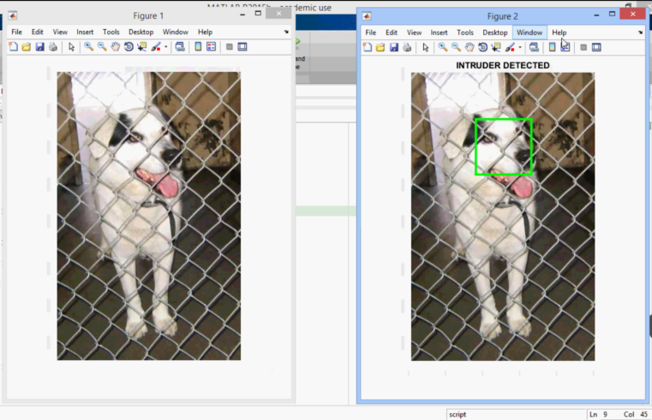
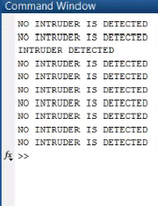
Simulation Results
Positive Input Image

Slide 22
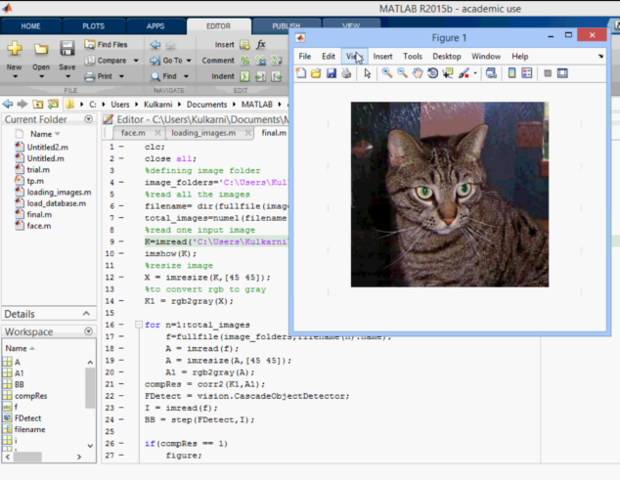
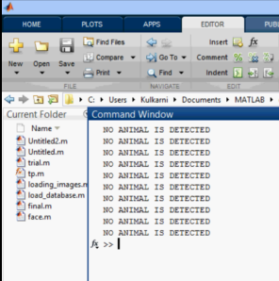
Negative input Image

Slide 23
Work done before lockdown
Selection of the components
Formation of the block diagram
Simulation and implemetnation of the transmitter and reciever.
PIR sensor testing
Collection of database for image processing

Slide 24
Work done in lockdown
Analyzing and testing various algorithms
Implementation and testing Viola-Jonnes algorithm
Interfacing of GSM, Stepper motor and other components to microcontroller through simulation
Final Report preparation
Paper presentation

Slide 25
Work distribution
Omkar- image processing algorithm
paper presentation
Anjali- database collection
paper presentation
coding & simulation
Shubham- LATEX report
coding and simulation
powerpoint presentation

Slide 26
REFERENCES
[1].A.Gandhimathi, P.Madhumitha, T.Kalaivani, “Solar Power Fencing
System for Agriculture Protection using GSM ”, International Journal
of Innovative Research in Computer and Communication Engineering
Vol. 4, Issue 12, December 2016
[2].Davide Adami , Fabio Vignoli, “ IoT Solutions for Crop Protection
against Wild Animal Attacks” , ResearchGate Conference Paper March 2018
[3]. Debarati Dutta,“ Laser Security System”, International Journal of
Scientific & Engineering Research, Volume 7, Issue 4, April-2016
[4].Dugyala Karthik, R. Ramesh Babu , “Smart Crop Protection System
with Image Capture over IOT” , International Journal of Advanced
Information Science and Technology (IJAIST) ISSN: 2319:2682 Vol.6,
No.11, November 2017
[5].Vikhram. B, Revathi. B,Shanmugapriya.R, Sowmiya.S,
Pragadeeswaran.G, “Animal Detection System in Farm Areas”,
International Journal of Advanced Research in Computer and
Communication Engineering, Vol. 6, Issue 3, March 2017

Slide 27
INFERENCES
REFERENCE | INFERENCE
1 | GSM INTERFENCING
2 | WIRELESS TRANSMISSION OF RECEIVED INPUT
3 | LASER
4 | IMAGE PROCESSING
5 | GSM INTERFENCING
FIELD VISIT | FARM IMPLEMENTATION

Slide 28


